Slide 1
Face recognition project
Dana Putra Kembara
VisionX

Slide 2
Project description
Introduction
Increasing demand for automated, accurate, and fair gender classification systems in applications such as demographic analysis, personalized services, and human-computer interaction, especially in cases where metadata is unavailable or unreliable.
Project’s goal:
Develop, train, and evaluate three CNN models (ResNet18, VGG16, and GoogleNet) to perform accurate gender classification directly from images.

Slide 3
Devices and tools
Hardware:
CPU: Intel Core Ultra 9
GPU: NVIDIA GeForce RTX 4060 (for training and inference)
RAM: 16 GB
Software:
Programming language: Python
Framework: PyTorch
Development: VS Code

Slide 4
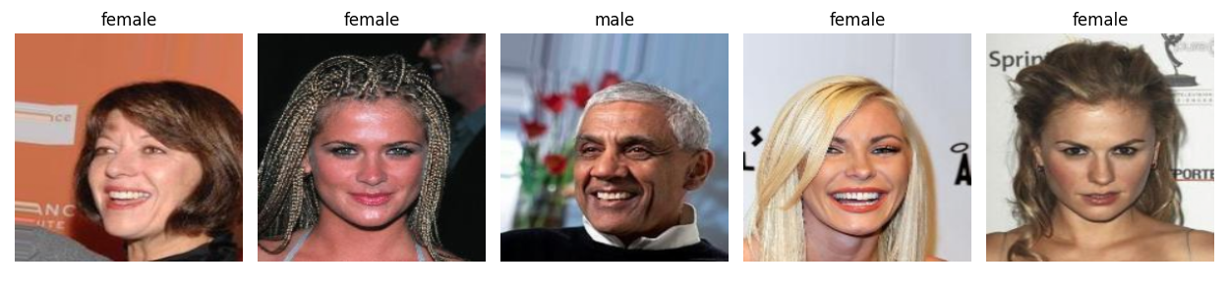
Dataset
CelebA dataset:
CelebA is a face attribute dataset with ~200K celebrity images, each with 40 attribute annotations
Open source link: https://mmlab.ie.cuhk.edu.hk/projects/CelebA.html)
In this project, we only use 5000 images and their annotations of the CelebA dataset

Slide 5
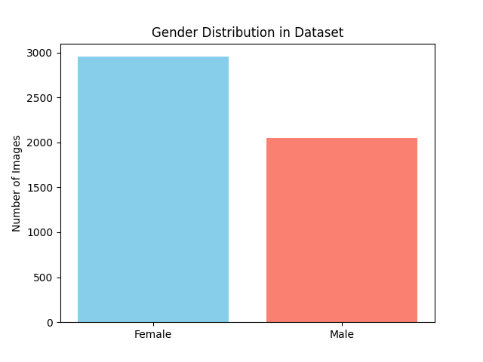
Dataset
Data cleaning:
Select relevant columns: ‘Filepath’ (image path) and ‘Male’ (gender label)
Filtered labels to match the available image file paths
Converted label into binary: ‘0’ (Female) and ‘1’ (Male)
Exploratory data analysis:
Class-imbalance is observed between gender
Stratify is applied to maintain equal gender proportion on each train/val/test set

Slide 6
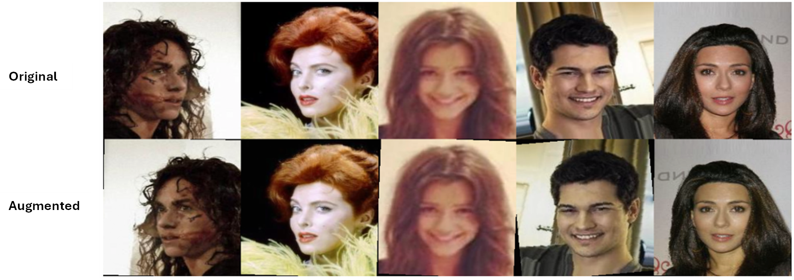
Training protocol
The dataset splitted into training, validation, and test sets using a 70/15/15 ratio, resulting in 3500 images for training, 750 for validation, and 750 for testing.
Data augmentation was implemented with 50% probability:
RandomRotation(10)
RandomHorizontalFlip()
ColorJitter(brightness, contrast, and saturation = 0.2; hue = 0.1)

Slide 7
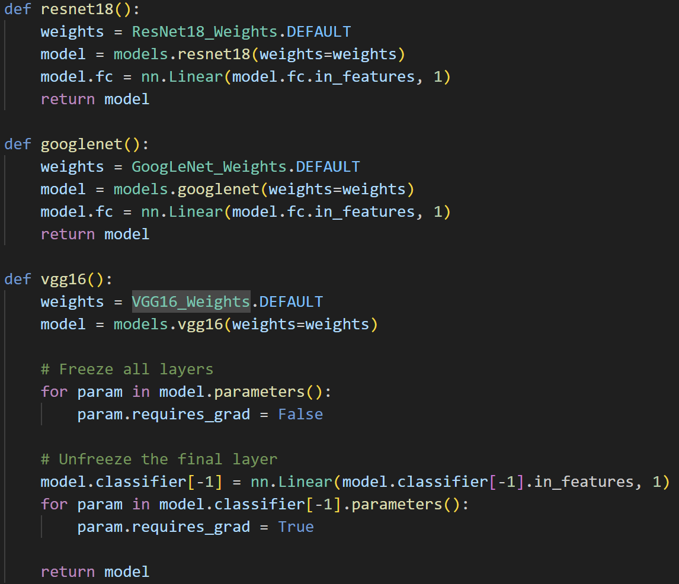
Model development
Load pre-trained models
Modify the last layer to solve binary classification problem
Fine-tuned only the classifier of VGG16 model using freezing weight
Model | Trainable parameters
ResNet18 | 11,177,025
GoogLeNet | 5,600,929
VGG16_fw | 4,097

Slide 8
Training protocol
Hyperparameters used:
Model’s weights are saved at the last epoch
Hyperparameter | Value
Epoch | 15
Batch size | 32
Learning rate | 0.001 with StepLR(step=5, gamma=0.1)
Criterion | BCELogitLoss
Optimizer | Adam

Slide 9
Evaluation metrics
Performance metrics:
Accuracy
Precision
Recall
F1-Macro
F1-weighted
Efficiency metrics
Training time
Inference time/image

Slide 10
Results and discussion
ResNet18 outperformed all models on every metric
GoogLeNet performed well, closely behind ResNet18
VGG16_fw lagged significantly, likely due to freezing weight that limited fine-tuning capability
Model performance was influenced by data augmentation, architecture, and hyperparameters
Model | Accuracy | Precision | Recall | F1-macro | F1-weighted | Training time | Inference time/image
ResNet18 | 98% | 0.968 | 0.984 | 0.979 | 0.98 | 26.61 min | 0.043 s
GoogLeNet | 97.33% | 0.964 | 0.971 | 0.973 | 0.973 | 49.54 min | 0.048 s
VGG16_fw | 90.53% | 0.888 | 0.88 | 0.902 | 0.905 | 82.33 min | 0.176 s

Slide 11
Conclusion and future improvement
Conclusion
ResNet18 outperformed GoogLeNet and VGG16_fw with an F1-macro of 0.979, F1-weighted of 0.980, training time of 26.6 min, and inference time of 0.043 s/image. Its high accuracy and efficiency make it ideal for real-world use.
Future improvement:
Increase dataset size from the CelebA dataset
Apply gender-specific augmentation
Try different layer-freezing strategies
Test smaller variants for VGG (VGG11, VGG13)

Slide 12
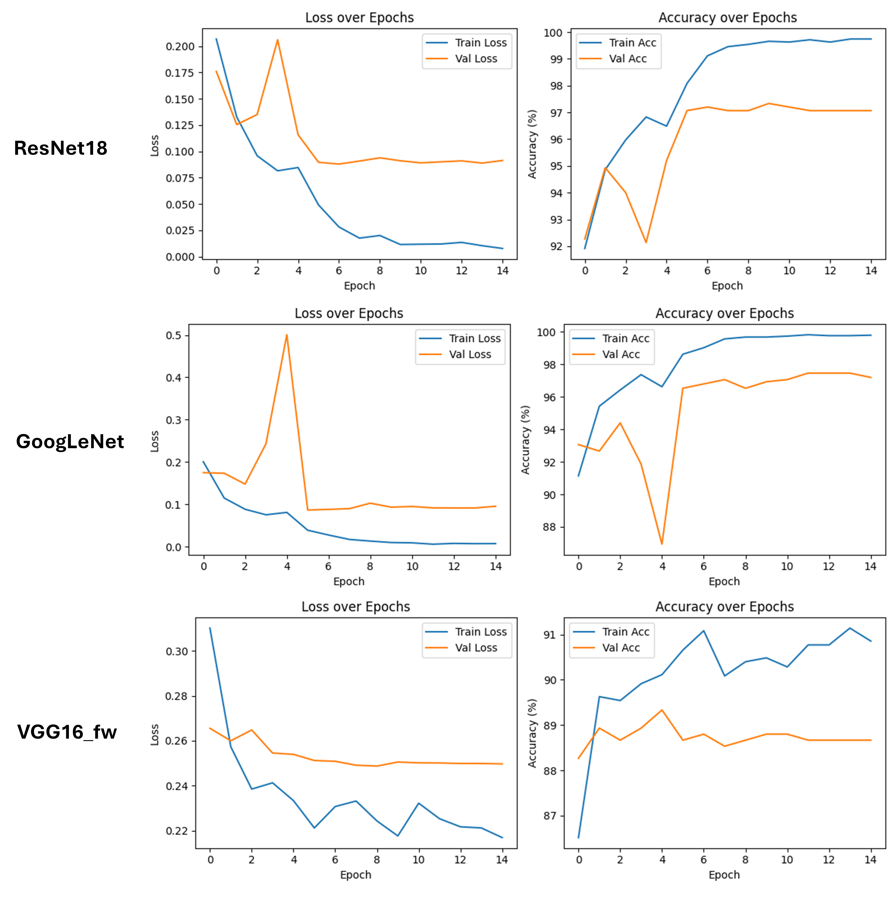
Appendix 1

Slide 13
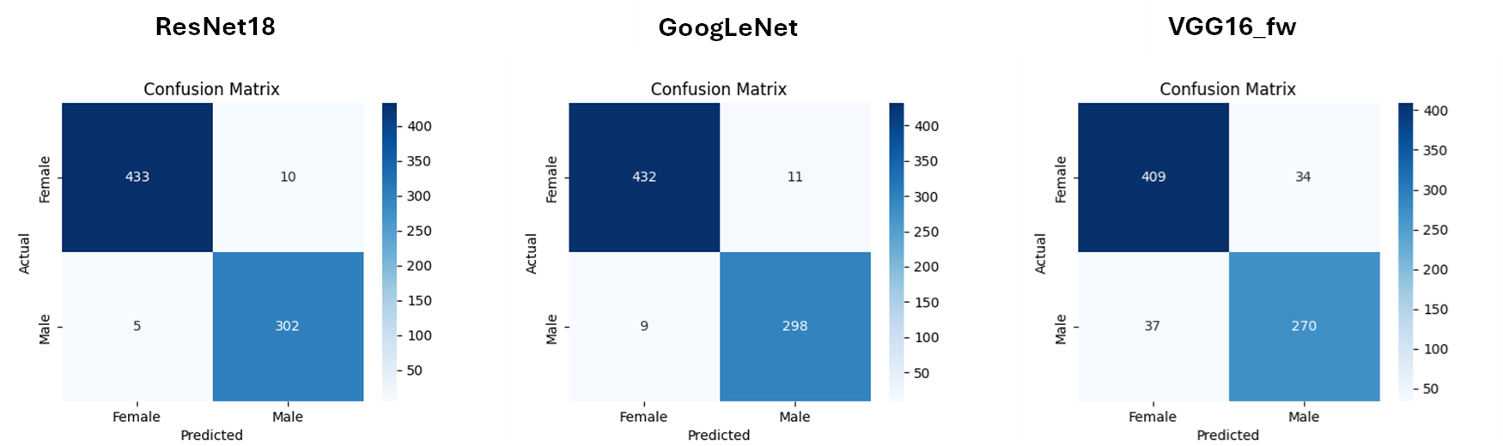
Appendix 2

